Slide 1
Technology Review:
Peak Detection
Jaime, Keertana, Sabiha, Theresa, and Chowdhury

Slide 2

Background & Motivation
Voltammetry is a sensitive analytic technique that informs us about the thermodynamics and kinetics of electron transfer for a given analyte/catholyte.
Current workflow for analyzing CV data is old school.
In order to enable high throughput data analysis we need nicer tools.
Isn’t that gonna be great, if you don’t have to plot your data manually, don’t have to analyze them one by one?
https://sop4cv.com

Slide 3
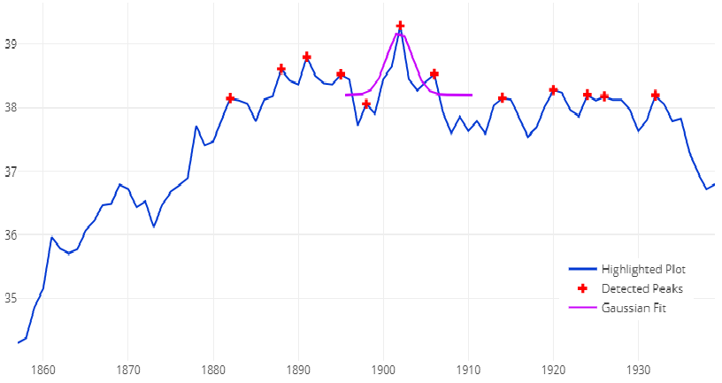
PeakUtils from Plotly
PeakUtils is a peak finding algorithm
Benefits:
Main methods: detection, fitting, interpolation, baseline, data preparation
Favorable for live plotting
Default draws all peaks
Limitations:
Poor detection of flatter peaks and plateaus
Predominantly operates on 1D arrays
Inconsistencies around sharp peaks
https://plot.ly/python/peak-fitting/

Slide 4
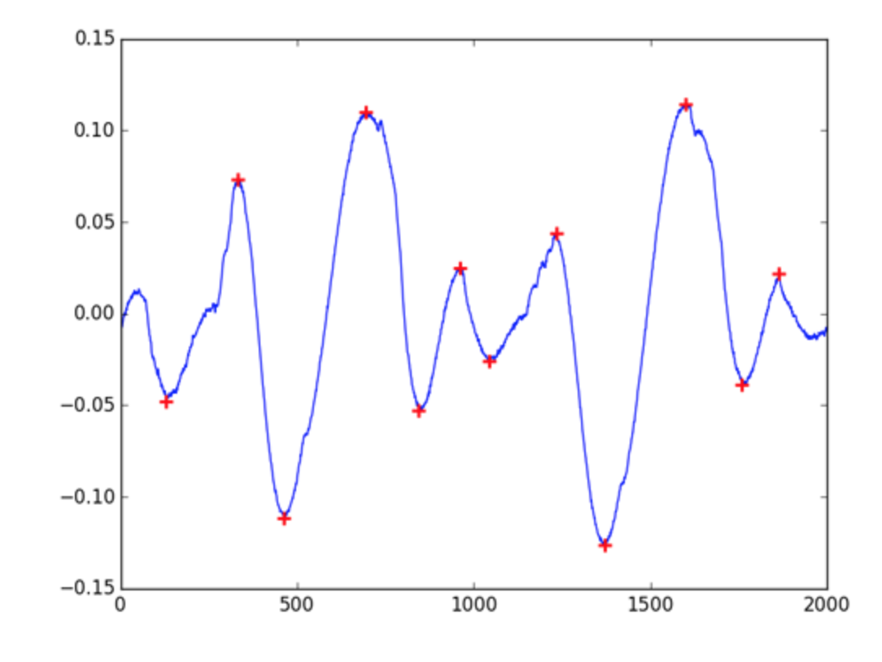
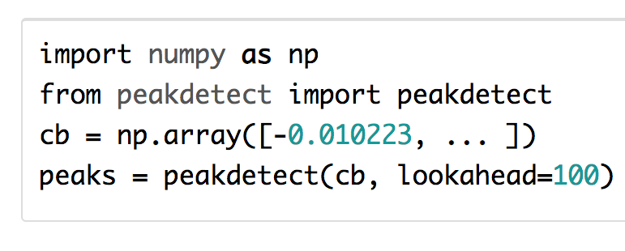
peakdetect by Sixtenbe
Peakdetect is a translation of a Matlab script.
Pros:
Attempts to emulate Matlab’s findpeaks.
Single file source that is trivial to use.
Cons:
Won’t give same results as findpeaks.
Algorithm falls short on low sampled signals.
Minimal support for filtering.
https://blog.ytotech.com/2015/11/01/findpeaks-in-python/

Slide 5
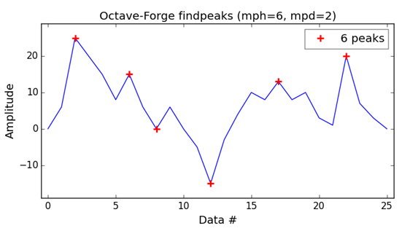
Octave-Forge Signal Package
Octave is a high-level programming language for scientific computing. The Octave-Forge Signal Package contains a findpeaks function
Benefits:
Last updated April 2018. There is plenty of documentation.
It can detect both local maxima and local minima
Drawbacks:
Requires oct2py bridge for python. Requires a complicated and inefficient setup to be called from python code
Returns value of data at peaks and an index indicating their position. Indexation is Matlab style, so need to subtract 1 for python.
Expects a single column vector input
Source of image: https://github.com/MonsieurV/py-findpeaks
Notes:
-Octave is a high-level programming language for scientific computing. It was originally created to teach undergraduates chemical reactor design, now has been used as the primary computational tool to teach an online machine learning class at Stanford. Encourage sharing with a GNU general public use license
-Signal package last updated 04/30/2018, plenty of documentation
-For findpeaks function, data is expected to be a single column vector. Can detect both local maxima and local minima by specifying “DoubleSided”. Need to specify MinPeakHeight, MinPeakDistance (min distance between peaks, below this they are considered one peak), and MinPeakWidth or else be okay with defaults. Returns the value of data at peaks and an index indicating their position. Matlab style indexation so to get back to python need to subtract 1. Then can be plotted via matplotlib or something
-needs oct2py bridge for python

Slide 6
Final Plan
We will be using PeakUtils
Peak detection
Peak fitting
Peak smoothing
Baseline detection

